Slide 1

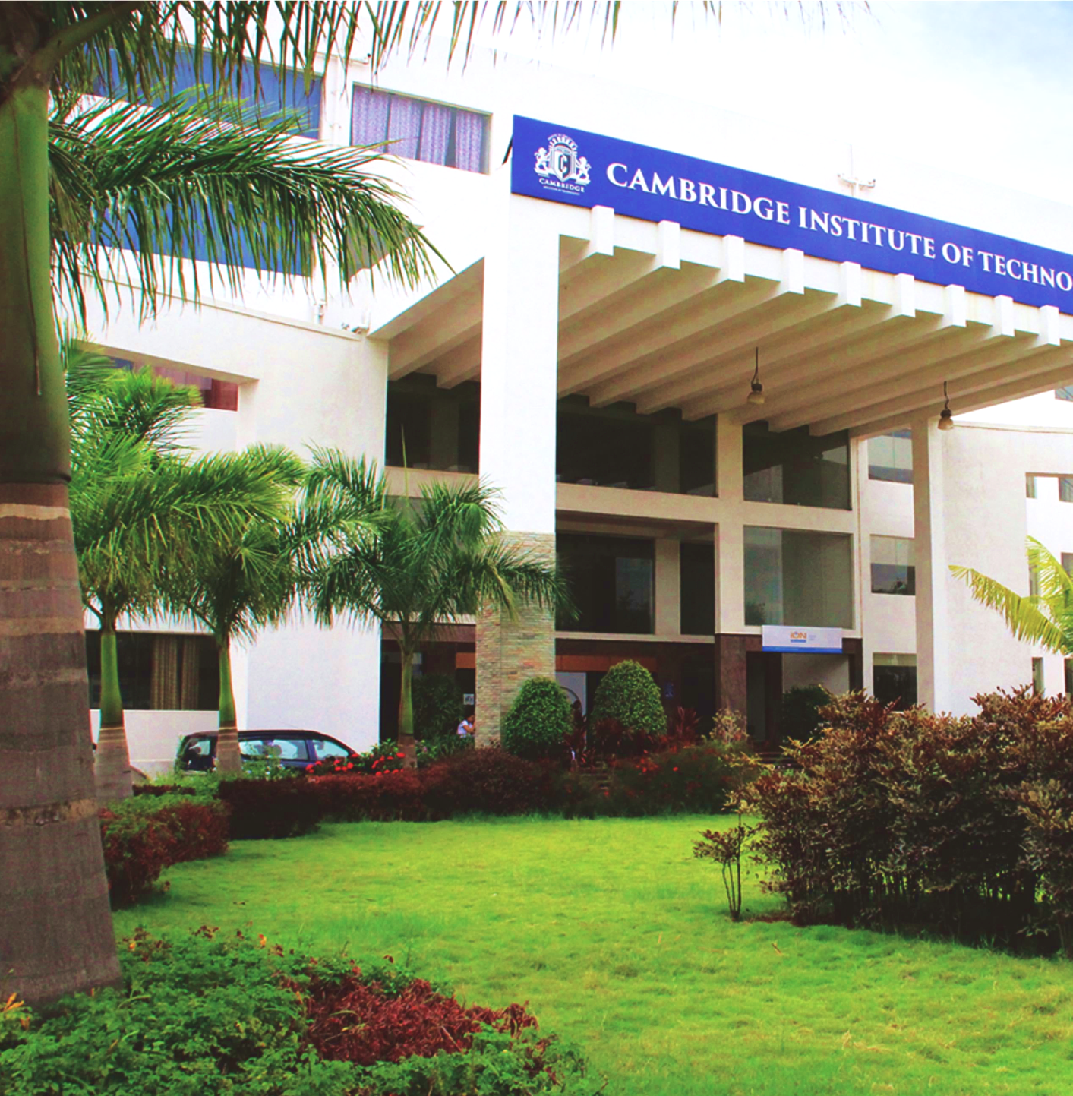
www.cambridge.edu.in
Project Work
Subject Code: 21AIMP67
Project Name:
Text Summarization Using GPT Models
Presented By :
Bheemambika B 1CD21AI006
Inchara V 1CD21AI019
Department of Artificial Intelligence and Machine Learning

Slide 2

ABSTRACT
The exponential growth of digital information necessitates efficient methods to condense lengthy texts into manageable summaries. This project explores the application of GPT models for text summarization, aiming to develop an automated tool that generates concise, coherent, and informative summaries. Key challenges include information retention, coherence, generalization and scalability. The project involves building a Streamlit-based web application that allows users to input text or upload PDFs, choose summarization styles, and get high-quality summaries. The system also provides interactive querying, enhancing information accessibility and usability.
Department of Artificial Intelligence and Machine Learning www.Cambridge.edu.in

Slide 3
INTRODUCTION
The "Text Summarization Using GPT Models" project leverages advanced generative AI to automate the process of summarizing lengthy texts into concise and informative summaries. With the increasing volume of digital information, this tool aims to enhance information accessibility and usability by extracting key information from extensive documents. The project utilizes GPT models, known for their ability to generate human-like text, ensuring that the summaries are coherent and informative. The advancement of machine learning and NLP, particularly with the advent of Generative Pre-trained Transformers (GPT), has revolutionized text summarization. GPT models, developed by OpenAI, have demonstrated remarkable capabilities in understanding and generating human-like text. These models leverage vast amounts of data and sophisticated neural network architectures to generate coherent, contextually relevant, and concise summaries.
Department of Artificial Intelligence and Machine Learning www.Cambridge.edu.in

Slide 4
PROBLEM STATEMENT
“Develop an advanced text summarization tool leveraging GPT models to condense large texts into brief, accurate summaries.”
Department of Artificial Intelligence and Machine Learning www.Cambridge.edu.in

Slide 5
OBJECTIVES
1. Develop Automated Summaries:
Utilize GPT models to generate concise, coherent, and informative summaries that retain essential information from lengthy texts.
2. Create an Intuitive User Interface:
Implement a user-friendly Streamlit-based web application that allows easy interaction for inputting text, uploading PDFs, and selecting summarization styles.
3. Offer Multiple Summarization Styles:
Provide users with various summarization options, including Brief, Detailed, and Key Points, to cater to different needs and preferences.
4. Enable Interactive Querying:
Allow users to ask questions about the summarized text and receive accurate, contextually relevant answers, enhancing information accessibility and usability.
Department of Artificial Intelligence and Machine Learning www.Cambridge.edu.in

Slide 6
Literature Survey
SL NO | PAPER TITLE | JOURNAL NAME | DESCRIPTION | PROS | CONS
1 | Text Summarization using NLP Technique | 2022 International Conference on Distributed Computing, VLSI, Electrical Circuits and Robotics (DISCOVER)by N. Balaji et al. | This paper explores NLP techniques for text summarization, focusing on deep learning methods such as transformers. It evaluates the performance and efficiency of these models in accurately summarizing text, highlighting their strengths and challenges in practical applications. | High accuracy in summarization and utilizes state of the art transformers Utilizes state of the art transformers for better performances | High computational resources required Complexity in implementation
2 | Building Customized Chatbots for Document Summarization and Question Answering using Large Language Models using a Framework with OpenAI, Lang chain, and Streamlit. | Journal of Information Technology and Digital World by Sangita Pokhrel et al. | This paper presents a framework for developing customized chatbots for document summarization and question answering. Utilizing OpenAI's language models, Lang chain, and Streamlit, the framework aims to enhance document interaction and information retrieval efficiency. | Utilizes advanced language models for effective summarization and Q&A. Integrates OpenAI, Lang chain, and Streamlit for a comprehensive framework. Improves information retrieval efficiency | Requires significant computational resources. Potential challenges in handling diverse document formats. Dependence on OpenAI's infrastructure.
Department of Artificial Intelligence and Machine Learning www.Cambridge.edu.in

Slide 7
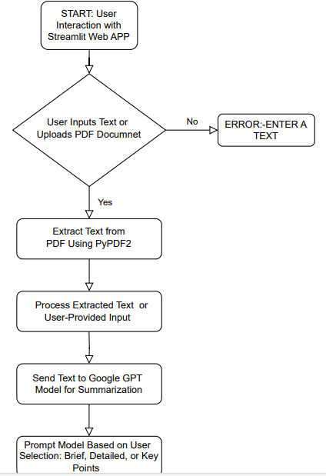
Methodology
Department of Artificial Intelligence and Machine Learning www.Cambridge.edu.in

Slide 8
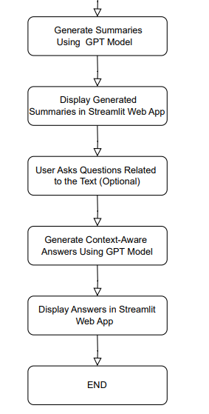
Methodology
Department of Artificial Intelligence and Machine Learning www.Cambridge.edu.in

Slide 9
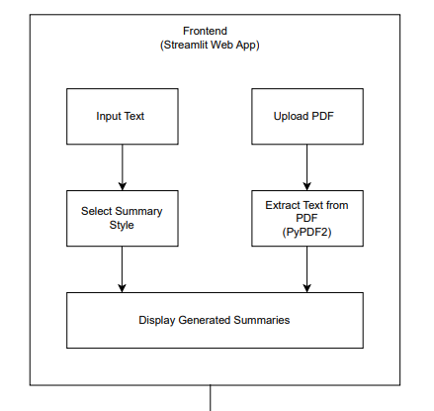
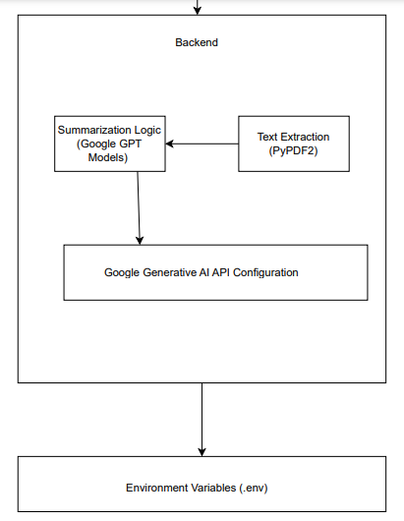
System Architecture
Department of Artificial Intelligence and Machine Learning www.Cambridge.edu.in

Slide 10
Tools and Technologies
Hardware Requirements :
Processor : a minimum dual-core processor.
Storage : minimum 256 GB SSD.
RAM : 8GB to 32GB RAM.
Internet Connection : Required for accessing the Google Generative AI API.
.
Department of Artificial Intelligence and Machine Learning www.Cambridge.edu.in

Slide 11
Tools and Technologies
Software Requirements :
Streamlit : Framework for building the web application.
Python : Python 3(Programming language for development).
PyPDF2 : Library for PDF text extraction.
Google Generative AI : API for accessing GPT models.
Dotenv : Library for managing environment variables
Department of Artificial Intelligence and Machine Learning www.Cambridge.edu.in

Slide 12
Implementation
1. Data Collection and Preprocessing:
Collect diverse text data for training and fine-tuning the GPT model.
Preprocess the data by cleaning and standardizing it to ensure consistency and quality.
2. Model Selection and Fine-Tuning:
Choose a pre-trained GPT model from the Google Generative AI suite.
Fine-tune the model specifically for text summarization tasks using the prepared dataset.
3. Development of Web Application:
Use Streamlit to build an intuitive web interface for the summarization tool.
Integrate functionalities for text input, PDF upload, and selection of summarization styles.
Steps
Department of Artificial Intelligence and Machine Learning www.Cambridge.edu.in

Slide 13
Implementation
4. Summarization Process:
Implement functions to generate summaries based on user-selected styles (Brief, Detailed, Key Points).
Use the GPT model to process the input text and generate the desired summaries.
5. Interactive Querying:
Enable users to ask questions about the summarized text and receive relevant answers generated by the GPT model.
6. Evaluation and Optimization:
Continuously evaluate the quality of generated summaries using metrics such as scores and human assessments.
Optimize the model and application for better performance and user experience.
Steps
Department of Artificial Intelligence and Machine Learning www.Cambridge.edu.in

Slide 14
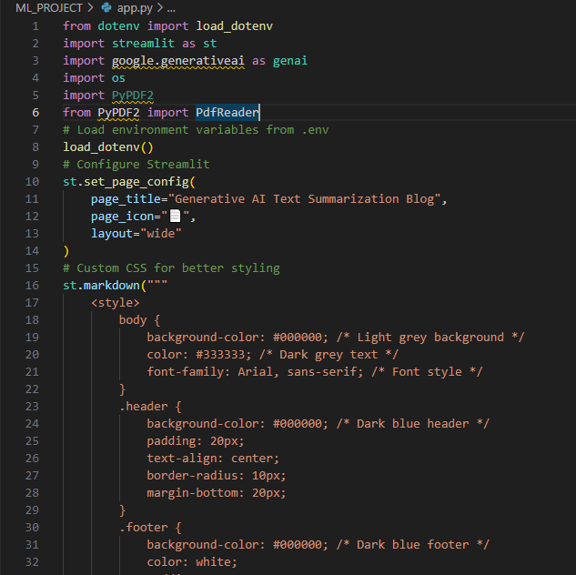
Code Snippets:
Department of Artificial Intelligence and Machine Learning www.Cambridge.edu.in

Slide 15
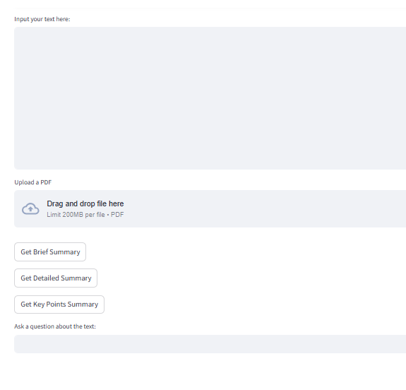
Output:
Department of Artificial Intelligence and Machine Learning www.Cambridge.edu.in

Slide 16
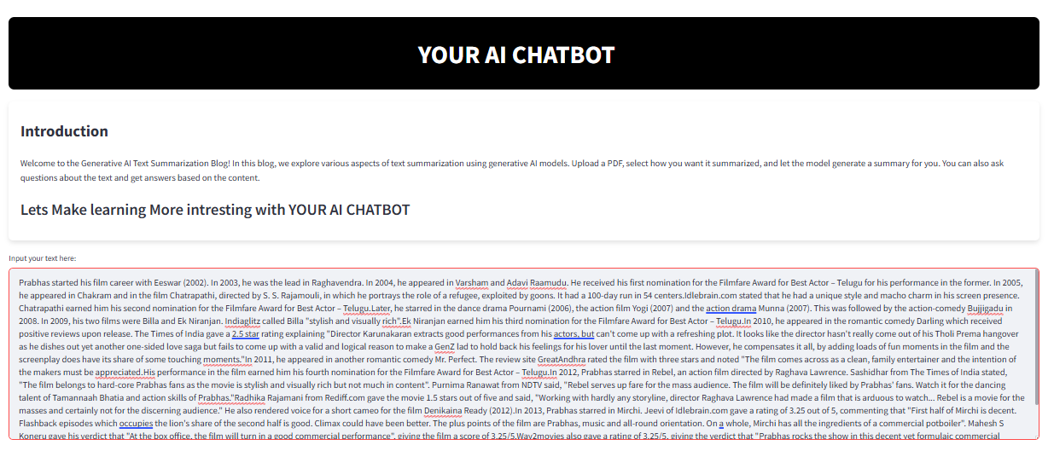
Results :
Department of Artificial Intelligence and Machine Learning www.Cambridge.edu.in

Slide 17
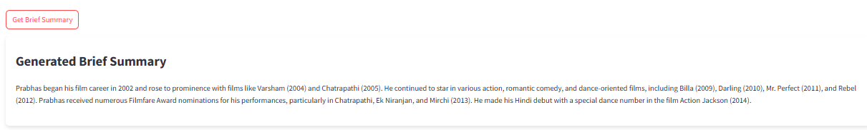
Results :
Department of Artificial Intelligence and Machine Learning www.Cambridge.edu.in

Slide 18
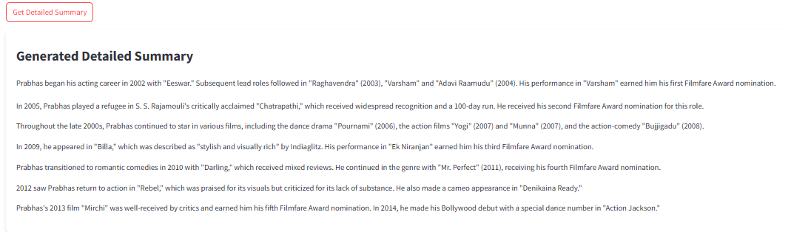
Results :
Department of Artificial Intelligence and Machine Learning www.Cambridge.edu.in

Slide 19
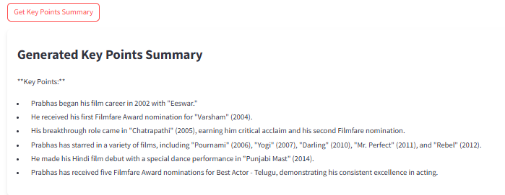
Results :
Department of Artificial Intelligence and Machine Learning www.Cambridge.edu.in

Slide 20
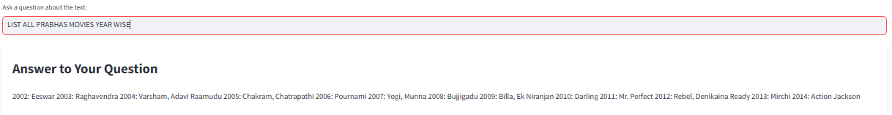
Results :
Department of Artificial Intelligence and Machine Learning www.Cambridge.edu.in

Slide 21
Applications
News Summarization
Research Paper Summarization
Business Intelligence
Customer Support
Educational Tools
Content Aggregation
Department of Artificial Intelligence and Machine Learning www.Cambridge.edu.in

Slide 22
Conclusion
The "Text Summarization Using GPT Models" project successfully demonstrates the use of generative AI to automate text summarization. The developed tool offers multiple summarization styles, ensures high-quality output, and handles various text types. The user-friendly interface allows easy interaction, making the tool accessible to a wide range of users. By providing concise and coherent summaries, the project significantly enhances information processing and accessibility.
Department of Artificial Intelligence and Machine Learning www.Cambridge.edu.in

Slide 23
FUTURE ENHANCEMENT
Improve model accuracy by continuously refine the model to enhance summary quality and accuracy. Expand summarization styles by introducing additional summarization styles to cater to diverse user needs. Multilingual support extend the tool's capabilities to handle texts in multiple languages. Advanced querying features which develop more sophisticated interactive querying features for deeper content insights. Integration with other platforms which Integrate the summarization tool with other platforms and applications for wider use. User feedback mechanism by Implementing a feedback mechanism to gather user inputs for continuous improvement. Real-time summarization which enhance the tool to provide real-time summarization for streaming data. Mobile application development which develop a mobile version of the application for on-the-go summarization.
Department of Artificial Intelligence and Machine Learning www.Cambridge.edu.in

Slide 24
References
[1]Radford, A., Narasimhan, K., Salimans, T., & Sutskever, I. (2018). Improving Language Understanding by Generative Pre-Training. OpenAI.
[2]Brown, T., Mann, B., Ryder, N., Subbiah, M., Kaplan, J., Dhariwal, P., ... & Amodei, D. (2020). Language Models are Few-Shot Learners. Advances in Neural Information Processing Systems (NeurIPS 2020).
[3]Lin, C.-Y. (2004). ROUGE: A Package for Automatic Evaluation of Summaries. Proceedings of the ACL-04 Workshop, 74–81.
[4]Wolf, T., Debut, L., Sanh, V., Chaumond, J., Delangue, C., Moi, A., ... & Rush, A. M. (2020). Transformers: State-of-the-Art Natural Language Processing. Proceedings of the 2020 Conference on Empirical Methods in Natural Language Processing: System Demonstrations.
[5]Vaswani, A., Shazeer, N., Parmar, N., Uszkoreit, J., Jones, L., Gomez, A. N., ... & Polosukhin, I. (2017). Attention is All You Need. Advances in Neural Information Processing Systems, 5998-6008.
Department of Artificial Intelligence and Machine Learning www.Cambridge.edu.in

Slide 25
THANK YOU
Department of Artificial Intelligence and Machine Learning www.Cambridge.edu.in

